Slide 1
Git’n Pro with HTML/CSS
Day 2
Wednesday, January 24, 2018

Slide 2
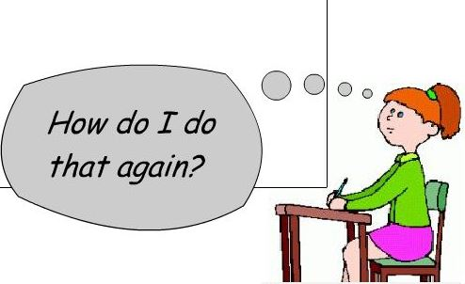
It’s Okay!

Slide 3
Admin Items

Slide 4
Where to Get Help
Practice, Practice, Practice: Work Individually or in Groups
Review In Class Material (Exercises and Slides)
Re-Watch Class Videos: https://codingbootcamp.hosted.panopto.com/Panopto/Pages/Sessions/List.aspx?folderID=d623fb7f-c667-4636-b61d-a86b0027c690
( I know it’s a mess, bookmark it!)
Pro Tip: Hit the RSS Subscribe button and the class videos will automatically download to your computer with iTunes or your favorite RSS program.
In Class Office Hours: 45 minutes before class, 30 minutes after
One-on-One Sessions: By Announcement through SSM
Contact Student Success: Anytime!

Slide 5
Homework #1 - Assignment
Also, at this point everyone should have access to the homework repository in GitHub. http://smu.bootcampcontent.com/SMU-Coding-Bootcamp/SMDA201801FSF4-Class-Repository-FSF
Homework Assignment #1 is due next week
MW Class: Who cares, that’s not us.
TTH Class: Next Saturday (February 3, 2018 by 10:00 AM CST)

Slide 6
Today’s Class!

Slide 7
Today’s Objectives
Students will understand the importance of Git Version Control and of how to use it.
Students will create GitHub Repositories, push code into them, and share with class.
Students will make more HTML documents.
Students will learn to properly use basic HTML tags.
Students will implement basic CSS styling to HTML documents.

Slide 8
Know Thyself
If you are a complete beginner to HTML/CSS and Coding:
Continue getting comfortable with HTML.
Be able to completely write a basic HTML document (like in last class).
Understand what CSS is, what it’s for, and how it works with HTML.
Be able to use Git and GitHub to upload code.
If you’ve had past exposure and felt comfortable with the last lesson:
Aim to build up your skills. Clear up any questions or confusions about HTML.
Become knowledgeable about a wider range of HTML and CSS tags.
Be able to selectively apply CSS to specific HTML elements.
Be able to use Git and GitHub to upload code.

Slide 9
What / Why Git?

Slide 10
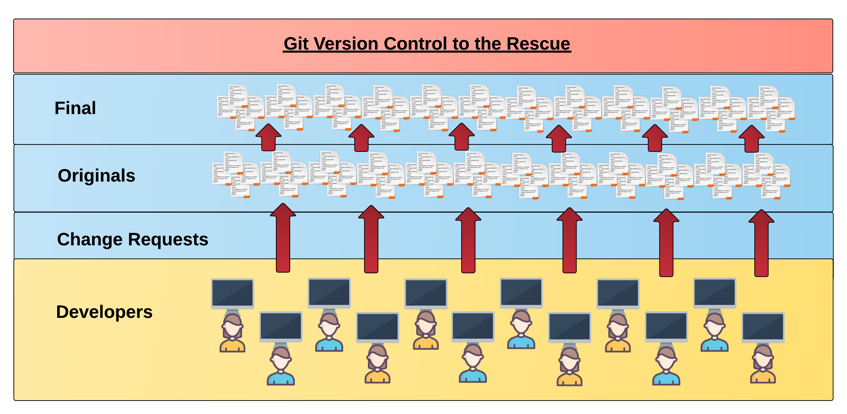
Collaborative Coding
Modern web development is highly collaborative.
Teams are often extremely large and separated across the country — or planet.
Apps sometimes comprise hundreds or even thousands of files.

Slide 11
The Team’s Task
Task: Make a list in HTML showing the three branches
of US government.

Slide 12
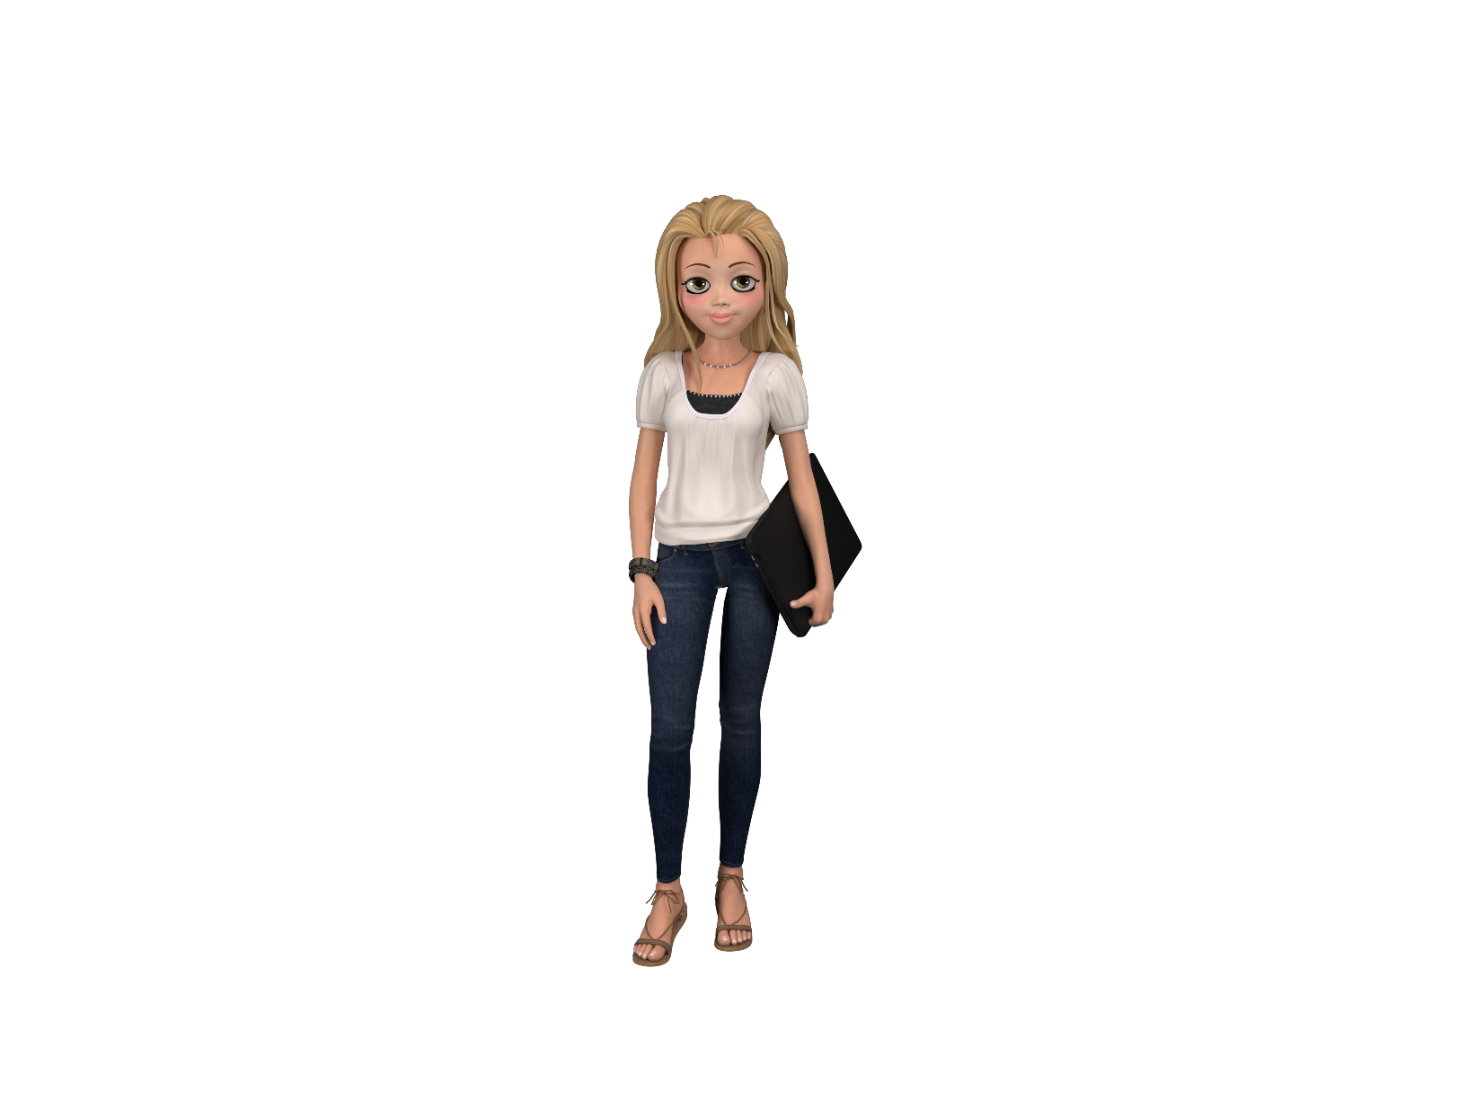

The Team
Programming Team:

Slide 13

Jasmin & Jacob make their edits
Programming Away…
Jasmine's Version
Programming Away…
Jacob’s Version

Slide 14
Different Solutions
<ul>
<li>Legislative</li> <li>Supreme Court</li> <li>Executive</li>
</ul>
<ul>
<li>Executive</li> <li>Congress & Senate</li> <li>Judicial</li>
</ul>
Different

Slide 15

Resolution
<ul>
<li>Legislative</li> <li>Supreme Court</li> <li>Executive</li>
</ul>
“Let’s settle on this…”
<ul>
<li>Legislative</li> <li>Judicial</li> <li>Executive</li>
</ul>
<ul>
<li>Executive</li> <li>Congress & Senate</li> <li>Judicial</li>
</ul>

Slide 16
This is harder than I thought.
We need more help.
I have an idea! Let’s get somebody off Craig’s List to help. I hear they work cheap!

Slide 17

Rumblebuffin (@stackoverflowTroll684)
Hai guyz!!!
How R Kan
help??

Slide 18
They give him access to the shared folder, and…
Delete. Delete. Delete. Delete.
Delete. Delete
<ul>
<li>Legislative</li> <li>Judicial</li> <li>Executive</li>
</ul>
<list>
<li>Washington <li>Dudes in Robes/li> <li>Mr. Hot Shot<li>
</list>

Slide 19
The Group Project
Lesson:
You should use Version Control.
….and back up your work!
….and watch your teammates’ work

Slide 20
Version Control
Git Version Control: Provides a organized system for managing code for when multiple developers work on a project
at the same time.
The Benefits of Git:
Automatically merges *most* work so teams can always easily get changes and updates made by team-mates
A process for resolving conflicts in code.
Version History

Slide 21
The Group Project
Master Branch
‘Branch’ = personal copy
Personal branch
Jasmin’s branch
Jacob’s branch
Rumblebuffin’s branch

Slide 22
The team goes to work
<ul>
<li>Legislative</li> <li>Supreme Court</li> <li>Executive</li>
</ul>
<ul>
<li>Executive</li> <li>Congress & Senate</li> <li>Judicial</li>
</ul>

Slide 23
Jasmin pushes first
Master Copy
1
Jasmin pushes (uploads) her code changes into the main branch.
No code conflicts.
Jasmin’s Branch

Slide 24
Jacob’s edits are ready
Rule: Pull first, then push your changes
Good idea!

Slide 25
Jacob pulls latest changes
Master Copy
1
Jacob’s Branch

Slide 26
Jacob’s conflicts with master branch
Master Branch
1
<li>Executive</li>
<li>Congress & Senate</li>
<li>Judicial</li>
<li>Legislative</li>
<li>Supreme Court</li>
<li>Executive</li>
Git sees a conflict.

Slide 27
Jacob’s resolves
<ul>
<li>Legislative</li> <li>Judicial</li> <li>Executive</li>
</ul>
<li>Executive</li>
<li>Congress & Senate</li>
<li>Judicial</li>
<li>Legislative</li>
<li>Supreme Court</li>
<li>Executive</li>
Jasmin’s Branch
Jacob’s Branch
They TALK to each other and agree.

Slide 28
Jacob fixes and pushes
Master Branch
1
2
Jacob pushes (uploads) his revision the main branch.
No code conflicts.
<ul>
<li>Legislative</li> <li>Judicial</li> <li>Executive</li>
</ul>
Jacob’s Branch

Slide 29
Rumblebuffin starts his work
Rule: pull first, then push your changes
Rules R 4 suckers!!!
MOOWHAHAHAHA!

Slide 30
Rumblebuffin pushes (without pulling first)
Master Branch
1
2
3
Rublebuffin pushes (uploads) his revision the main branch. No code conflicts.
Not what we want.
<list>
<li>Washington <li>Dudes in Robes/li> <li>Mr. Hot Shot<li>
</list>
Rumblebuffins’ Branch

Slide 31
If Rubmlebuffin had done a pull first…
Conflict!
<list>
<li>Washington
<li>Dudes in Robes/li>
<li>Mr. Hot Shot<li>
</list>
<ul>
<li>Legislative</li>
<li>Judicial</li>
<li>Executive</li>
</ul>

Slide 32
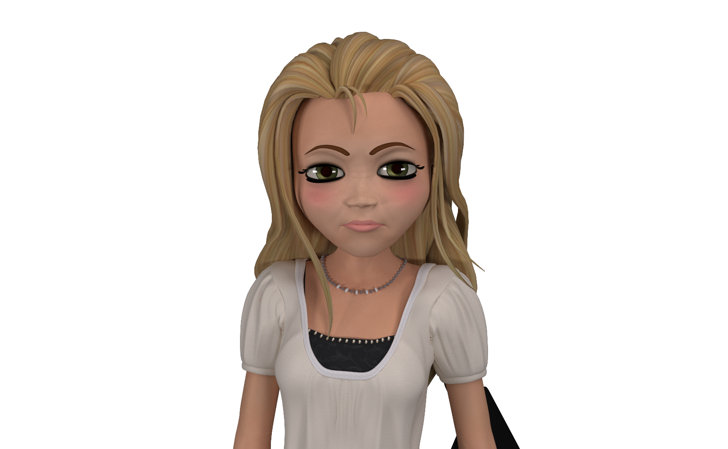
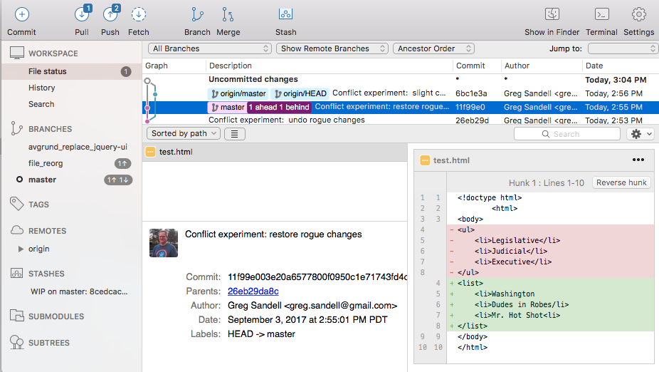
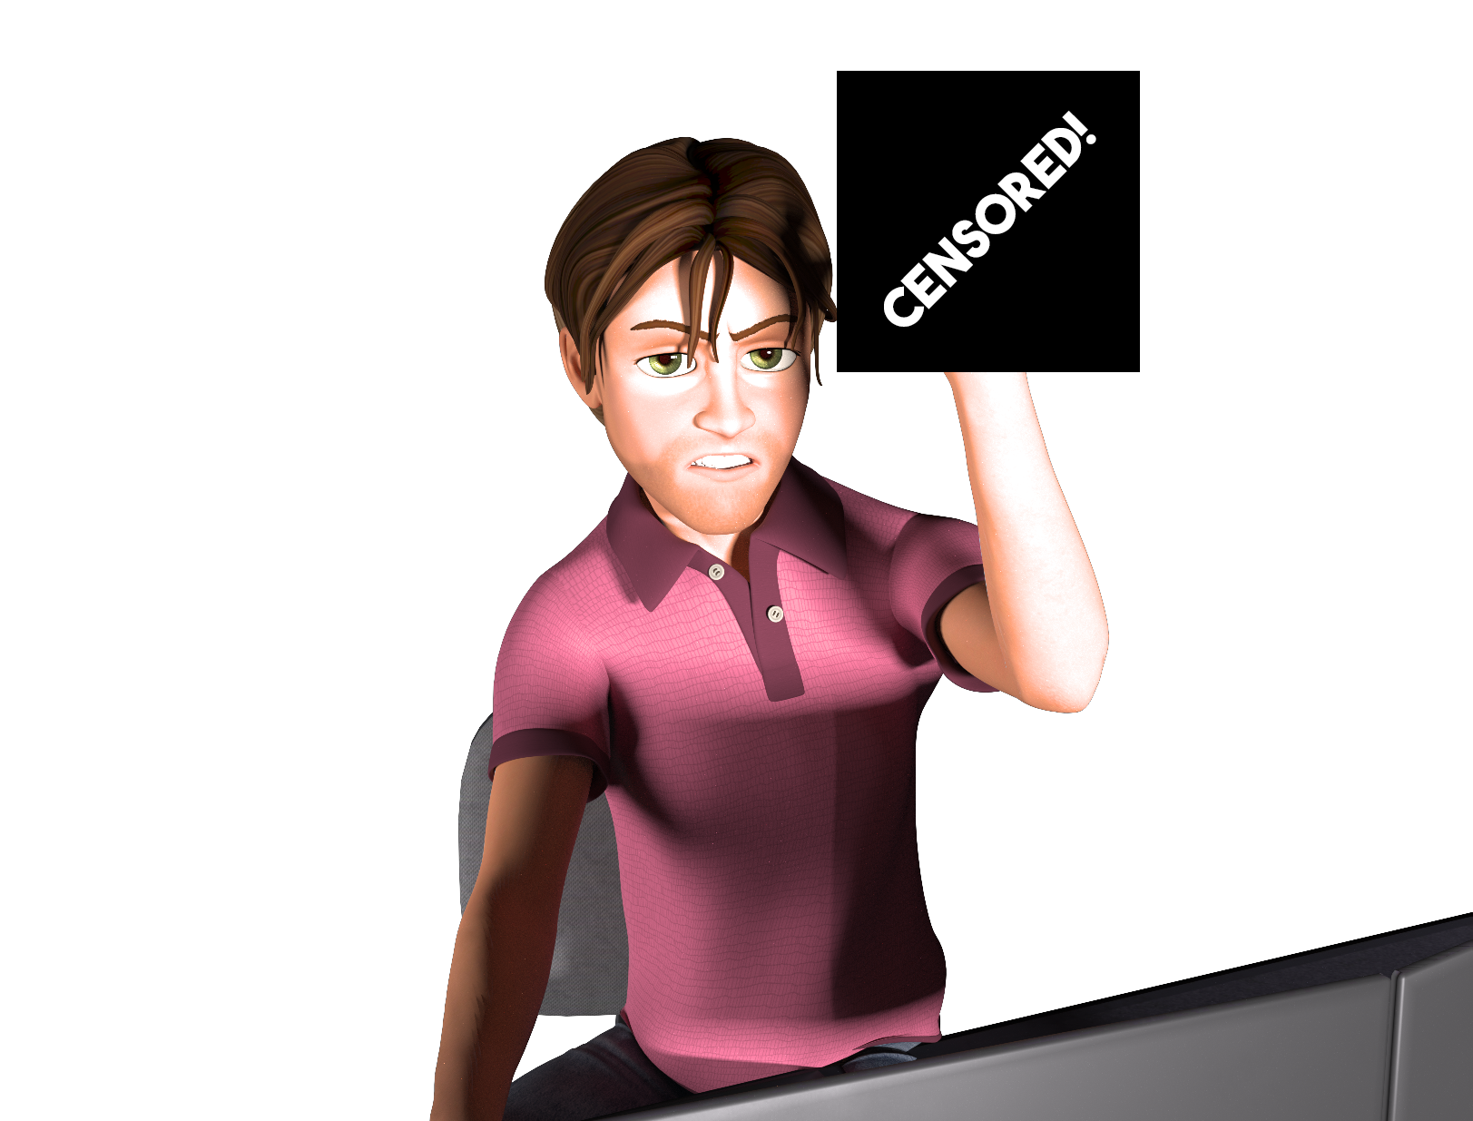
The overwritten work is discovered
NOOOOOOOOO!

Slide 33
Roll Back
Main Branch
1
2
3
4
Jasmin rolls back the code to an earlier version by copying version 2 into the working version, then committing it.
NOOOOOOOOO!
Rublebuffin’s Branch

Slide 34
The Group Project
Lesson:
You should use Version Control!
(and never hire Internet trolls off Craig’s List to be on your team)

Slide 35
Quick Activity!
Suggested Time: 3 min
Turn to your neighbor, and have one of you explain to the other:
The concept of version control.
Then the other should explain:
Two of the key advantages to using a version control system.

Slide 36

So… What’s this GitHub?
GitHub is a Web-Based hosting service to store code online.
It allows developers to pull (download) code or push (upload) code to the same repository (directory).
It also allows developers to view histories of code changes and to track issues.

Slide 37

Pushing and Pulling to GitHub
1
2
3
4
GitHub Branch
Pull Code
Push Code
Pull Code
Pull Code
Push Code
Pull Code
Push Code

Slide 38
Get Started with Git

Slide 39
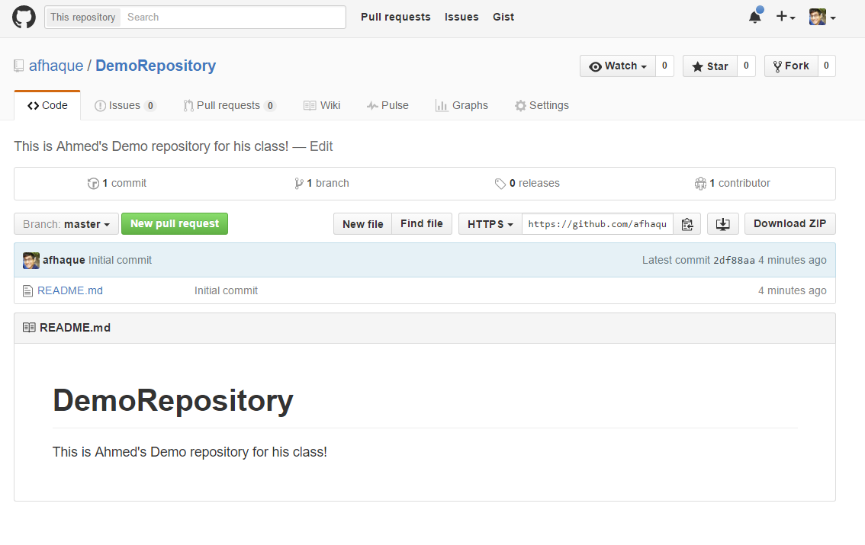
Instructor Git Demo!

Slide 40
Basic Git Commands
At its most basic, these are the five git commands to get started:
git clone
git add
git commit
git push
git pull

Slide 41
Basic Git Commands
At its most basic, these are the five git commands to get started:
git clone – copies an entire repo (to begin).
git add – adds a file for inclusion in Git.
git commit – notes a change to the local repo.
git push – sends changes to hosting service.
git pull – downloads freshest version of repo.

Slide 42
> YOUR TURN!
Activity: Git Add, Commit, Push | Suggested Time: 20 min
Assignment:
Using GitHub and the Command Line:
Create a new public GitHub repository and name it whatever you like. Be sure to check the box for “initialize this repository with a README.”
Next, clone the repo to your local directory.
Then create an HTML file inside the local directory.
Add, Commit, and Push the code to GitHub.
Bonus:
Find a partner in class, and fork their repository to your own GitHub account. Clone this forked repository to your local directory.
Add, Commit, and Push the code back to your forked copy.
Finally, submit a pull request to send your changes to your partner’s repo.

Slide 43

Still a Bit Lost? Never Worry!
Follow this handy Guide!
Practice a few times on your own before our next class.

Slide 44
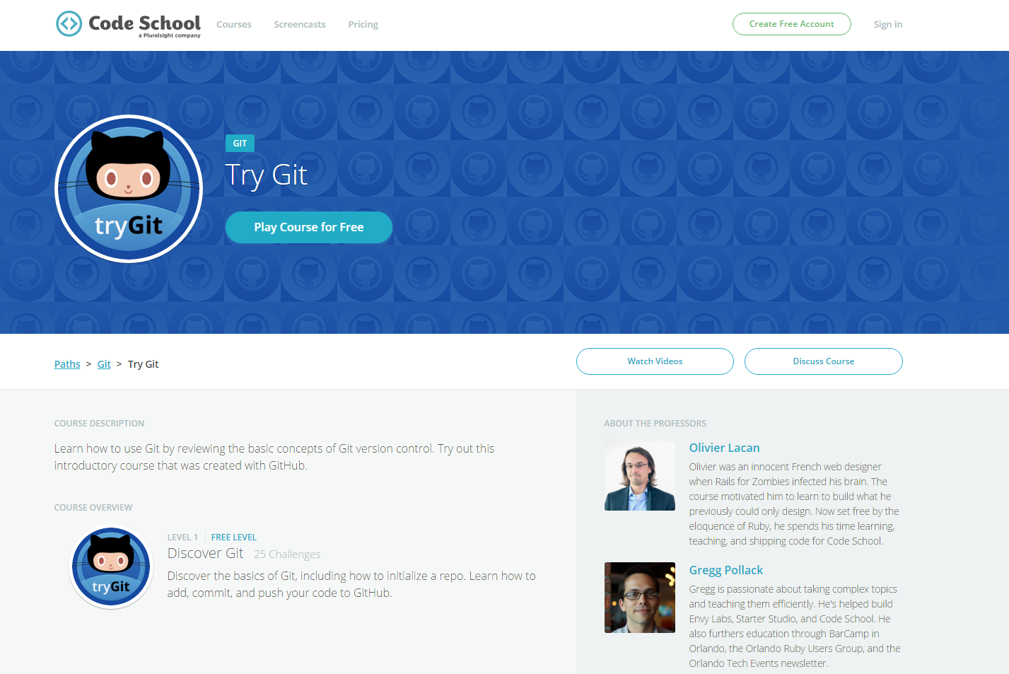
If You’re Still Lost… Here’s a (Free) Course
https://www.codeschool.com/courses/try-git

Slide 45
HTML Round 2

Slide 46
HTML Syntax (Basic)
Content
<h1>
This is Mah House
</h1>
Opening Tag
Closing Tag

Slide 47
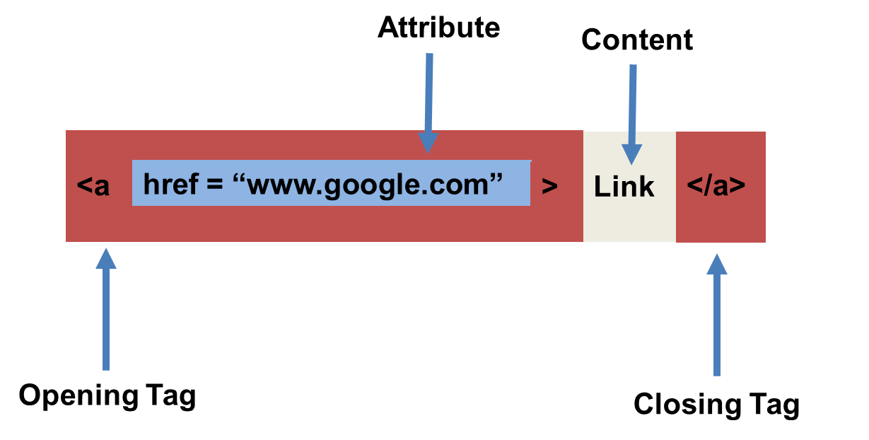
HTML Syntax (with Attribute)

Slide 48
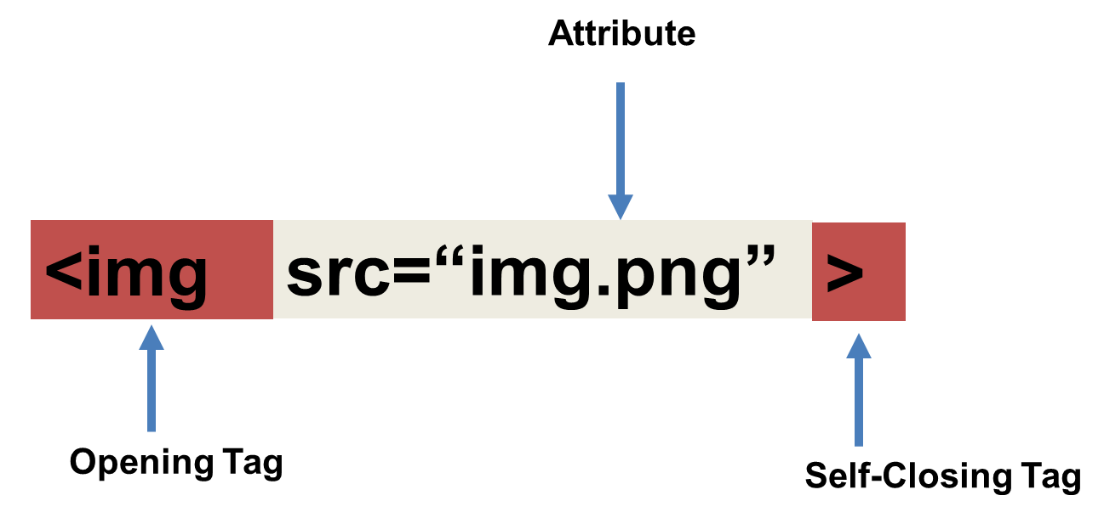
Tricky Tags (Self-Closing)

Slide 49
Important Common Tags
Headings:
<h1> </h1> - Heading 1 (Largest Heading)
<h2> </h2> - Heading 2 (Next Largest Heading)
<h3> </h3> - Heading 3
…
Containers:
<html> </html> - Wraps the entire page
<head> </head> - Wraps the header of the page
<body> </body> - Wraps the main content
<div> </div> - Logical Container ***
<p> </p> - Wraps individual Paragraphs
Others:
<strong> (bold), <em> (emphasis)
<img> (images), <a href> (links), <li> (list items) , <title> (title), <br> (line break), <table> (tables), <!-- --> (comments)

Slide 50
Less Common Tags
All HTML Tags are listed here: http://www.w3schools.com/tags/
Don’t try to memorize them! Simply refer back to documentation as needed.
Other tags:
<video> for Videos
<audio> for Audio files
<embed> for Embedded files
<code> for including computer code
<header> for headers
<nav> for navigation bars
<footer> for footers

Slide 51
HTML for Forms
Common UI (User Interface) Form Elements:
<form> - Creates a form section in HTML
<input> - Input boxes
<label> - Labels for boxes
<button> - Button
<textarea> - Large textbox

Slide 52
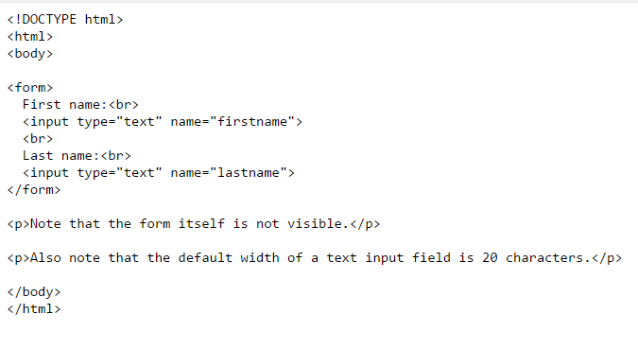
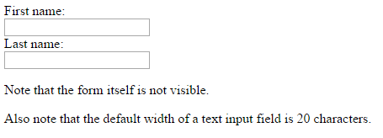
HTML for Forms

Slide 53
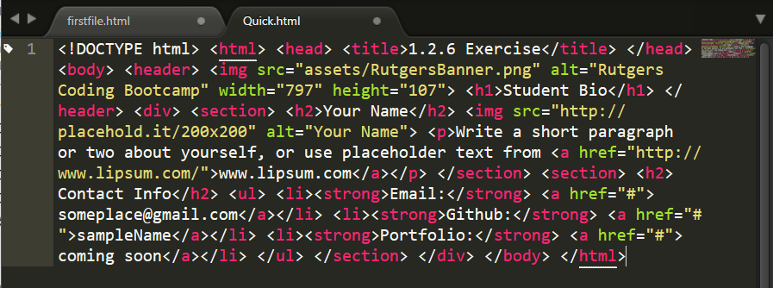
On Ugly HTML
Don’t do this… Use proper indentation and sectioning.
Readable code is easier to maintain.
Invest time to get better about this now. It will pay dividends!

Slide 54
> YOUR TURN!
Activity: 1-HTML_Git | Suggested Time: 20 min
Assignment
In this activity, you’ll create a student bio using HTML. You will then add, commit, and push your completed HTML to GitHub for the world to see.
Additional instructions, sent via Slack.

Slide 55
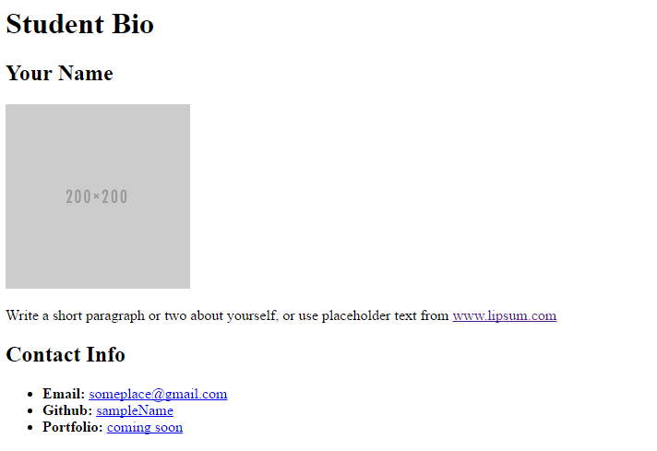
> YOUR TURN!

Slide 56
CSS Stylin’

Slide 57


HTML / CSS Definitions (*yawn* unimportant)
HTML: Hypertext Markup Language – (Content)
CSS: Cascading Style Sheets – (Appearance)
HTML/CSS are the “languages of the web.” Together they define both the content and the aesthetics of a webpage – handling everything from the layouts, colors, fonts and content placement. (JavaScript is the third – handling logic, animation, etc.)

Slide 58


HTML / CSS Analogy
HTML Alone
Like writing papers in “Notepad.”
Can only write unformatted text.
HTML / CSS
Like writing papers in Microsoft Word.
Can format text, page settings, alignment, etc. based on “highlighting” and menu options.

Slide 59
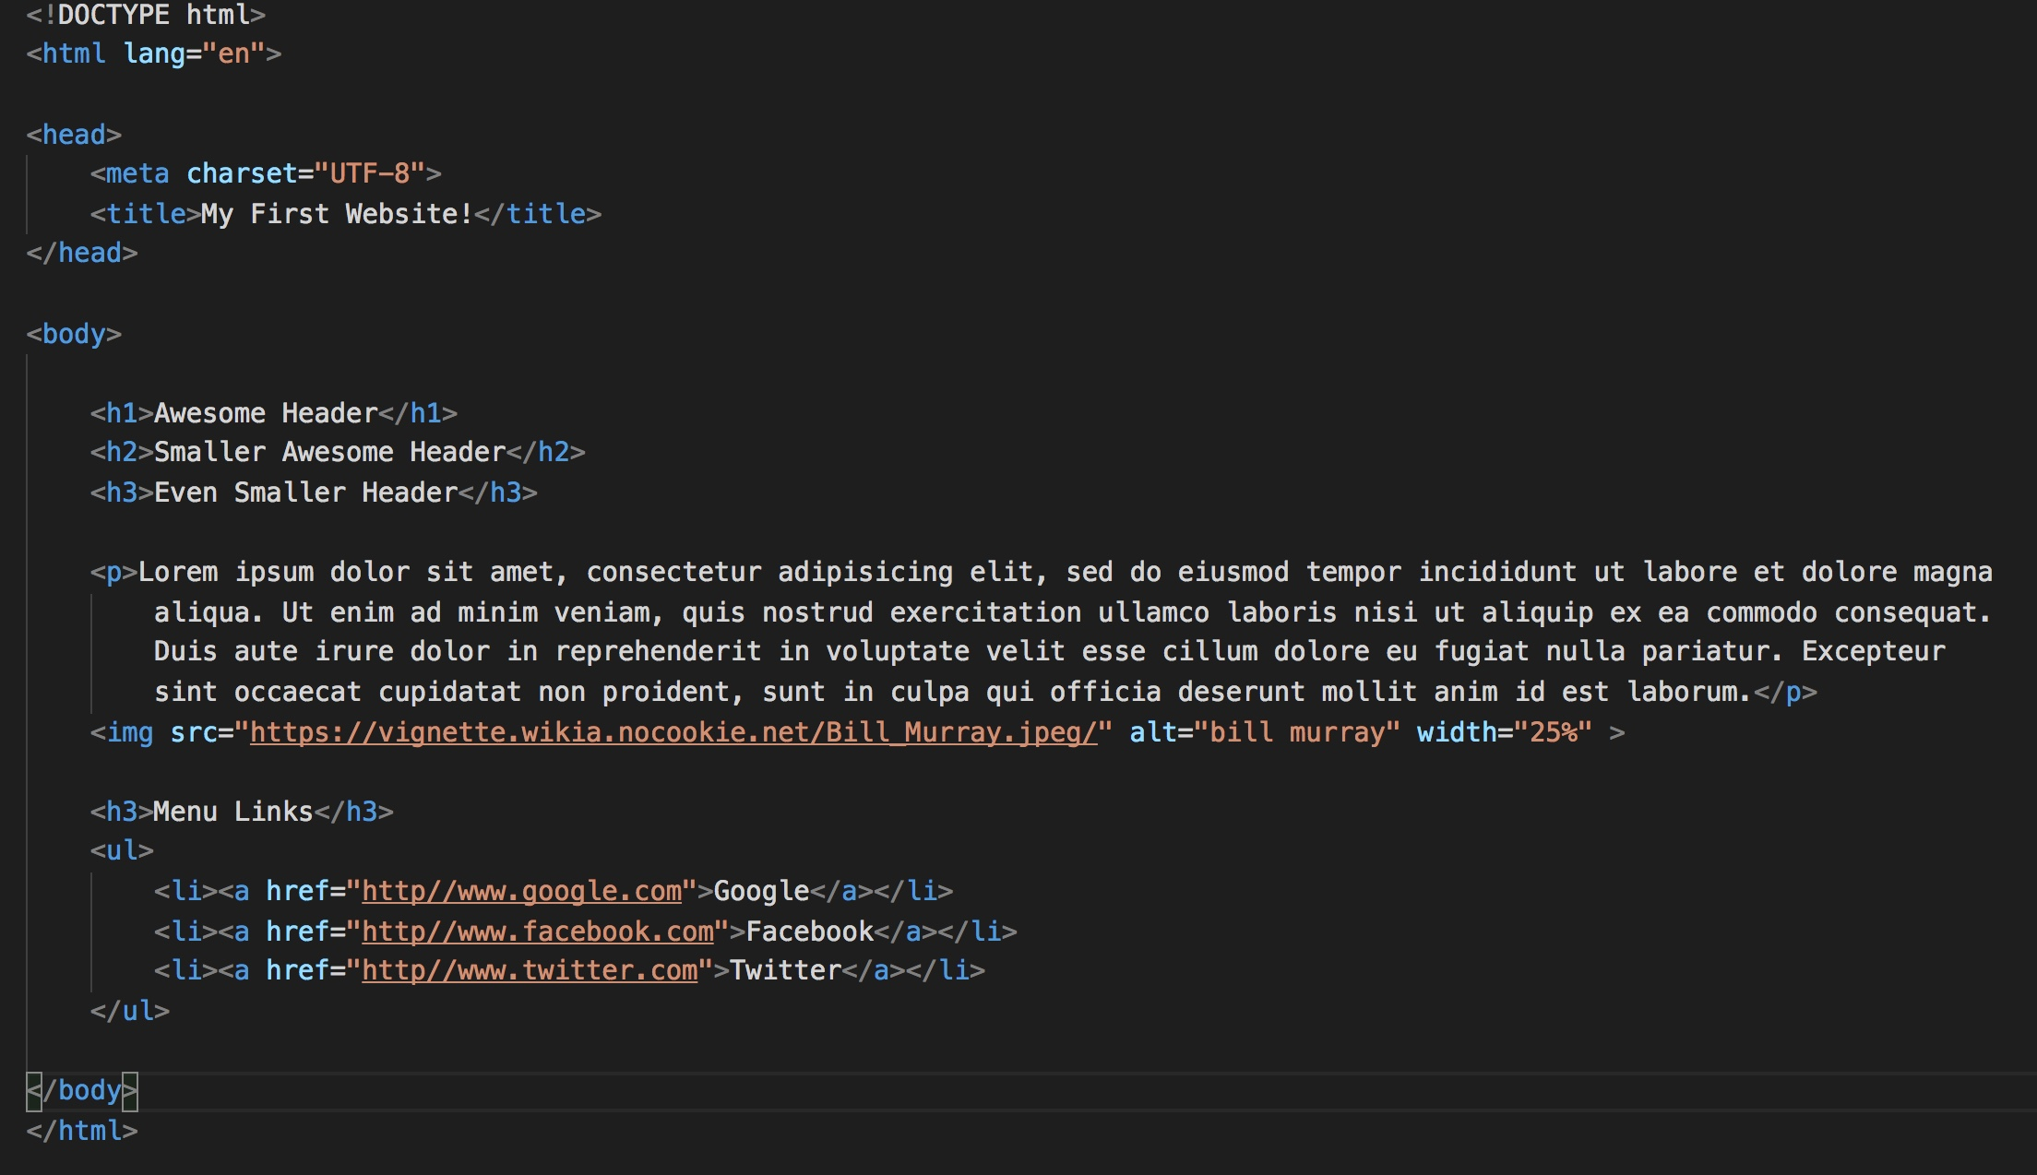
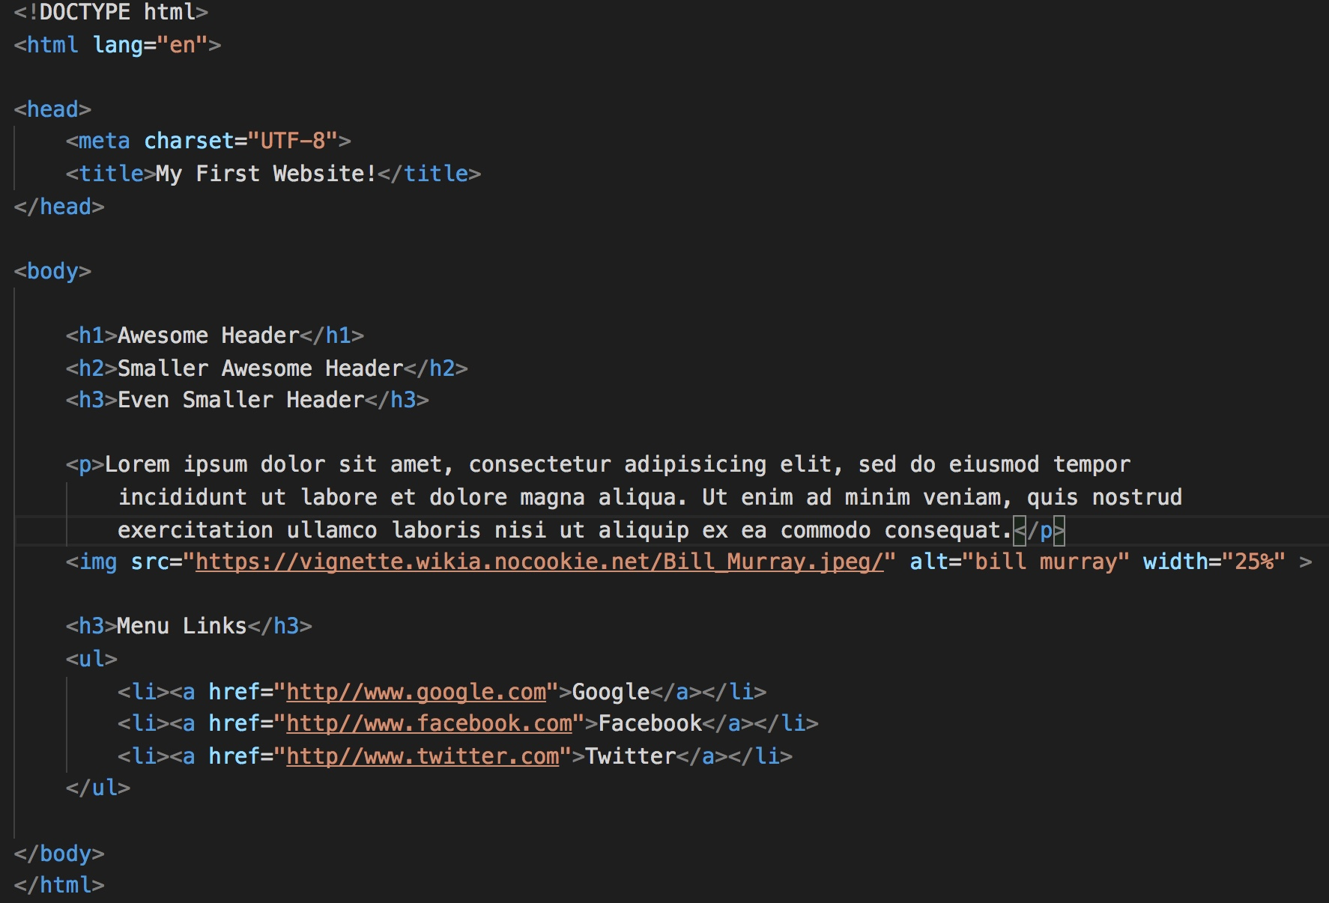
Basic HTML Page

Slide 60

Basic HTML Page - Result

Slide 61
Basic HTML Page - Result
Hella Boring…

Slide 62
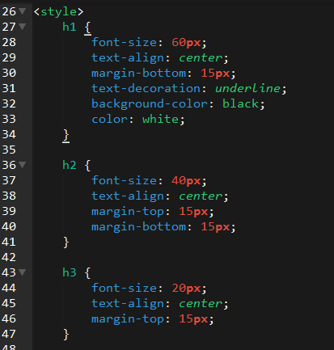
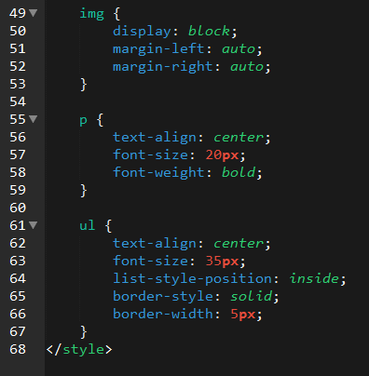
Enter CSS

Slide 63

Enter CSS - Result

Slide 64

CSS Syntax
CSS works by hooking onto selectors added into HTML using classes and identifiers.
Once hooked, we apply styles to those HTML elements using CSS.

Slide 65
CSS Example
In the below example the “Header” would be turned blue and MUCH larger because of the CSS.
We can incorporate an element’s class or ID to apply a CSS style to a particular part of the document.
Just remember to include the necessary symbol before the CSS: “.” for class, “#” for ID.
Example (HTML):
<p class=“bigBlue”>Header</p>
Example (CSS):
.bigBlue
{
font-size: 100px;
color: blue;
}

Slide 66
Key CSS Attributes
Font / Color:
color: Sets color of text.
font-size: Sets size of the font.
font-style: Sets italics.
font-weight: Sets bold.
Alignment / Spacing:
padding (top/right/bottom/left): Adds space between element and its own border.
margin (top/right/bottom/left): Adds space between element and surrounding elements.
float: Forces elements to the sides, centers, or tops.
Background:
background-color: sets background color.
background-image: sets background image.

Slide 67
Powerful Duo
Believe it or not, HTML / CSS is all you need
to develop a vivid, full-blown website.

Slide 68
INSTRUCTOR DEMO
Instructor: Demo
(quickexample_internalcss.html | 2-BasicCSS)

Slide 69
> YOUR TURN!
Activity: 3-HTML_CSS_Layout | Suggested Time: 20 min
Assignment
In this activity, you’ll upgrade your previous HTML bio-page using CSS style rules. Once you’re done, commit and push up your changes to GitHub.
We’ll send you additional instructions via Slack.

Slide 70
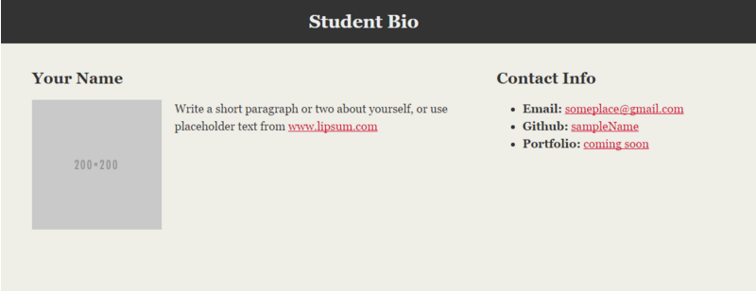
> YOUR TURN!

Slide 71
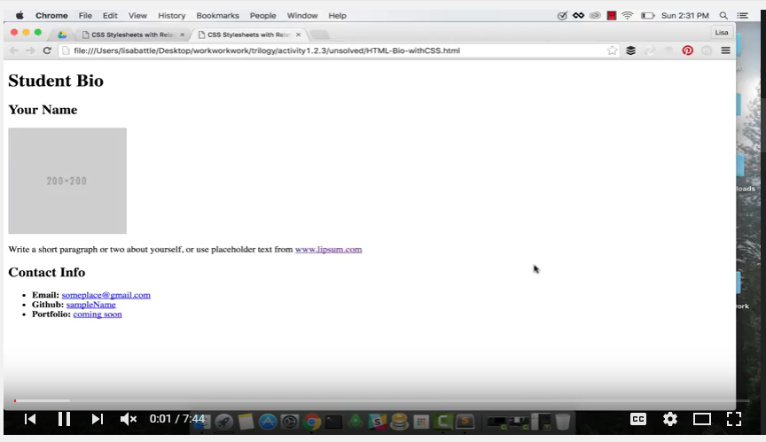
Video Walkthrough!!
https://www.youtube.com/watch?v=kMBinXTCrXI&list=PLgJ8UgkiorCnMLsUevoQRxH8t9bt7ne14&index=2

Slide 72

Still a Bit Confused?
Remember! We’ve got video guides for key activities like that last one.
If you feel like you are EVER falling behind, use those online walkthroughs to help catch back up. They are made to be easy to understand.
Still having trouble? Shoot your instructor or one of your TAs a message!
We are here to help you out in whatever way we can!

Slide 73
Recap + Questions

